Slide 1
Weather Data Analysis
SAGAR S
@sagarsudarshan

Slide 2
Context
This is a popular dataset about London weather, dated from 1979 to 2020.
Measurements were recorded by a weather station near Heathrow airport in London, UK.
15341 observations were recorded over a span of 41 years in the following verticals.
date - recorded date of measurement - (int)
cloud_cover - cloud cover measurement in oktas - (float)
sunshine - sunshine measurement in hours (hrs) - (float)
global_radiation - irradiance measurement in Watt per square meter (W/m2) - (float)
max_temp - maximum temperature recorded in degrees Celsius (°C) - (float)
mean_temp - mean temperature in degrees Celsius (°C) - (float)
min_temp - minimum temperature recorded in degrees Celsius (°C) - (float)
precipitation - precipitation measurement in millimeters (mm) - (float)
pressure - pressure measurement in Pascals (Pa) - (float)
snow_depth - snow depth measurement in centimeters (cm) - (float)

Slide 3
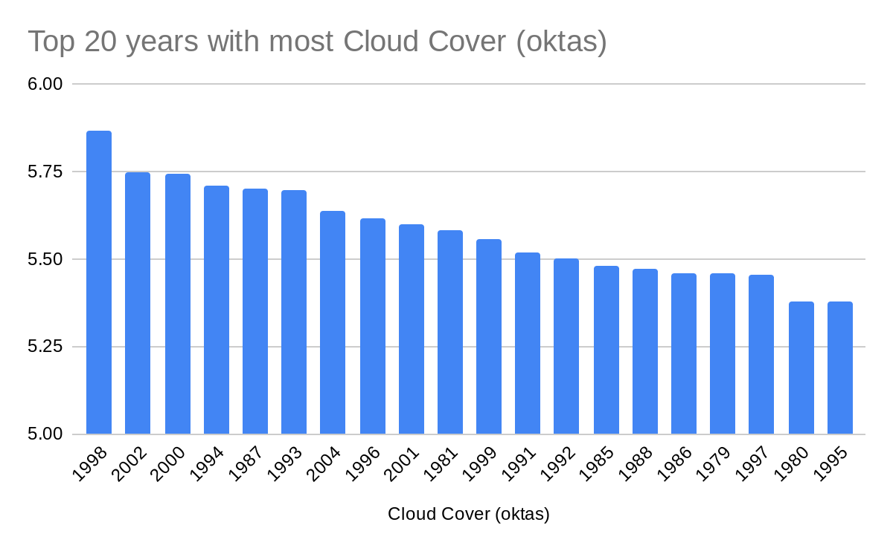
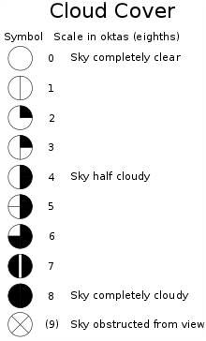

Slide 4
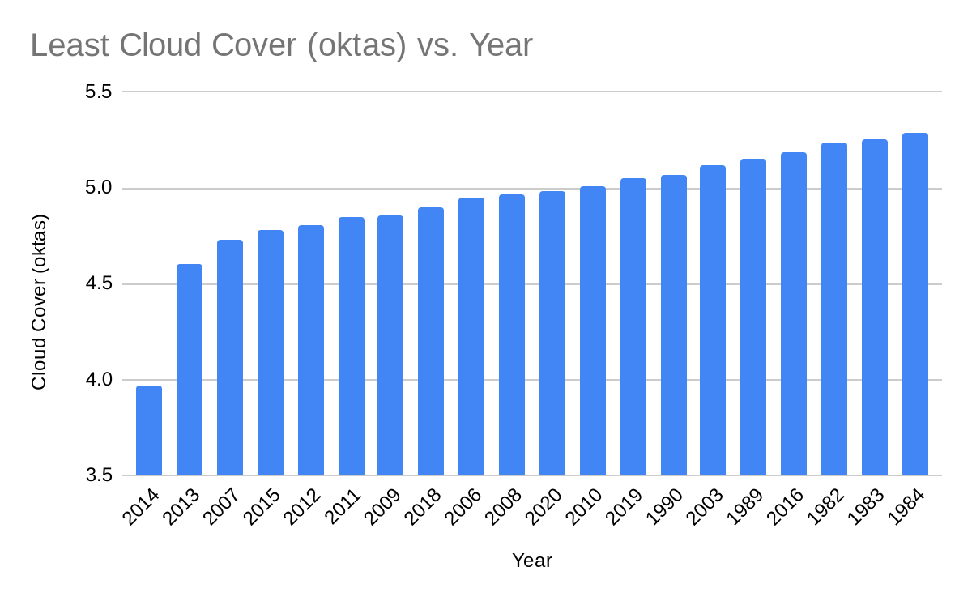

Slide 5
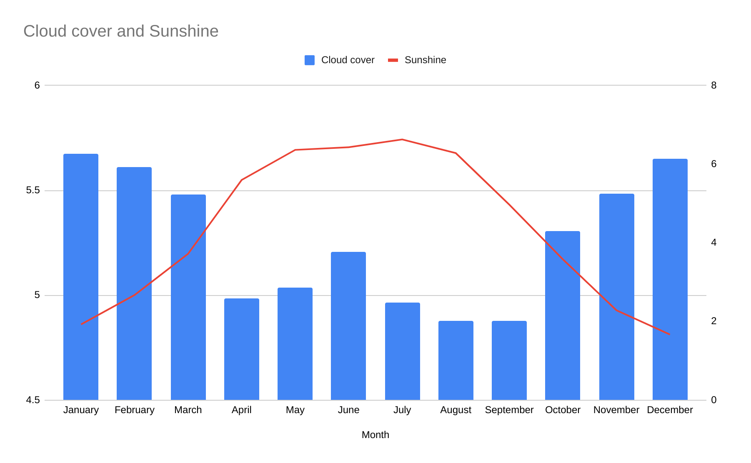

Slide 6
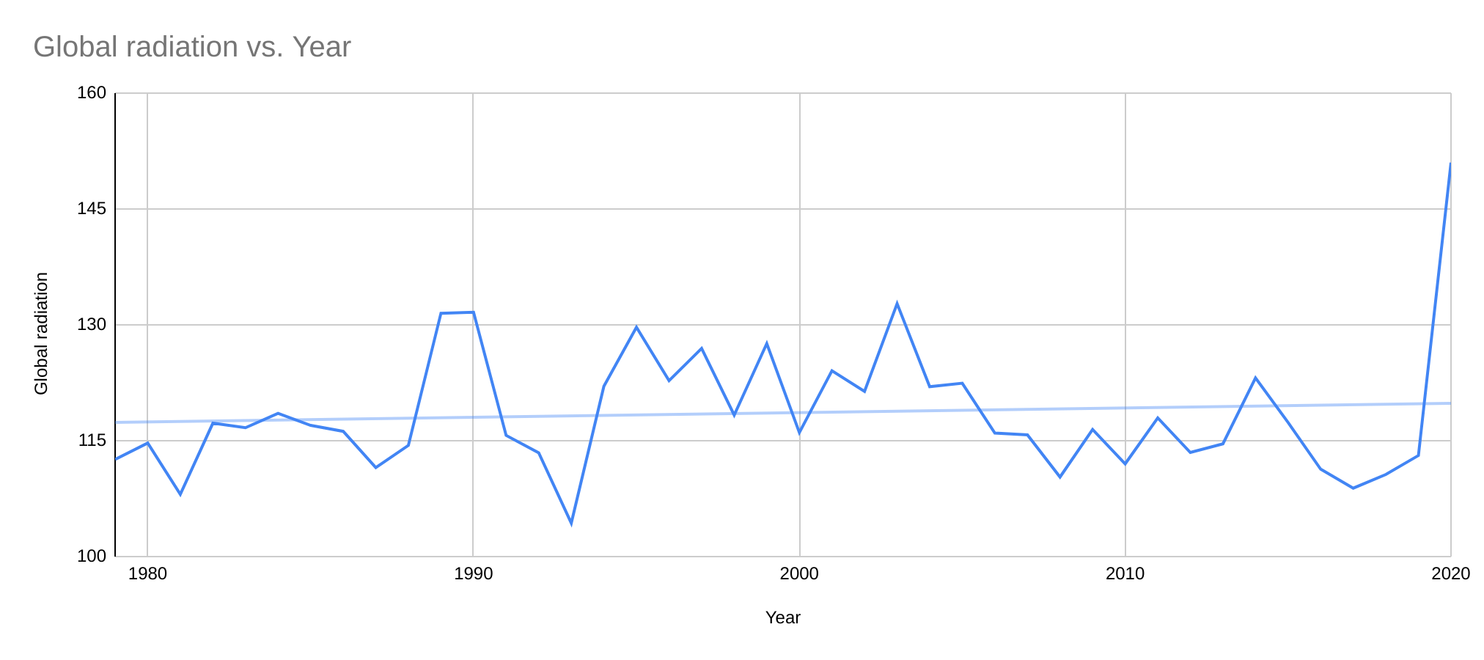

Slide 7
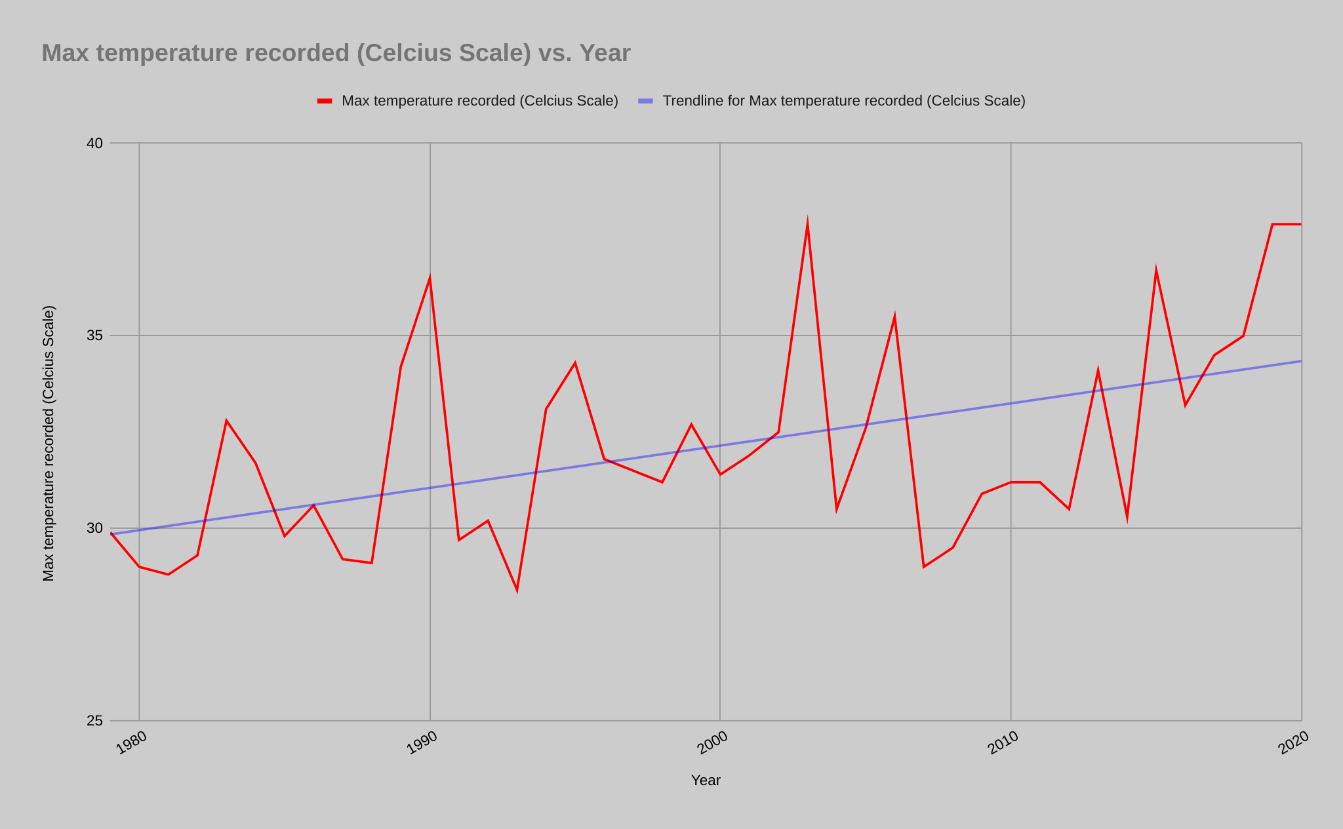

Slide 8
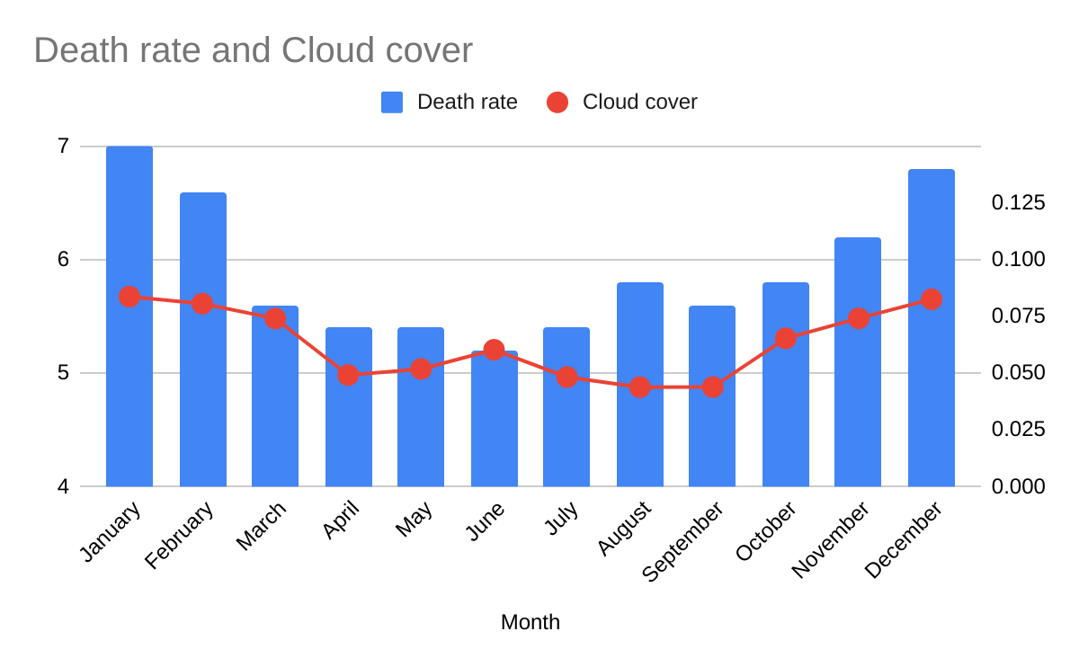

Slide 9
Summary:
Time period from 1998 to 2002 had the most Cloud cover.
Year 2013 to 2015 received the most sunshine.
2020 was the year with most Global Radiation by far.
May to August months recorded more sunshine.
Max temperature recorded has been increasing by each decade.
Most deaths occur from November to January, which has a positive correlation with cloud cover.
Thank You

